Slide 1

Date: | Human Biology Year 12 ATAR
Do Now Do the past exam question given. Lesson Agenda 1: Do Now 2: The Pancreas, insulin and glucagon, regulation and disorders 3: Complete Review Worksheet 4: Lesson summary and wind-up Suggested Study Finish review worksheet, mark and correct (strongly suggested) Read through today’s notes and textbook section Practice drawing flowcharts for insulin and glucagon regulation NEXT LESSON Past exam question (not for marks) Other endocrine glands | Learning Aims Describe the location and structure of the pancreas. Describe the production and effects of insulin. Explain how blood sugar is regulated via insulin. Describe the production and effects of glucagon. Explain how blood sugar is regulated via glucagon. Describe Diabetes Mellitus Type 1 and Type 2 in detail.
 | Key Vocabulary Glycogen Glucagon Insulin Pancreatic Islets Alpha cells Beta cells

Slide 2
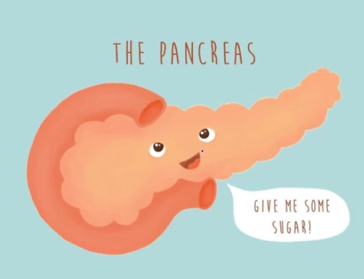
The Pancreas
Structure, Hormones, Regulation and Disease
Ch2 Human Perspectives

Slide 3
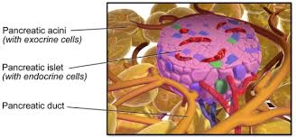
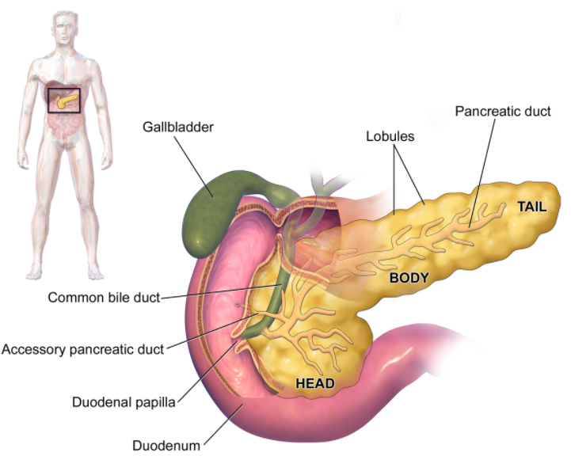
Pancreas location and structure
Located in abdomen, near duodenum
Leaf shaped organ
Has both exocrine and endocrine functions
Exocrine:
Produces amylase and lipase, which travel down ducts to intestine. Involved in digestion
Endocrine:
Produces hormones insulin and glucagon from clusters of tissue “Islets of Langerhans”
Regulation of blood sugar levels
Learning Aim: Describe the location and structure of the pancreas.

Slide 4
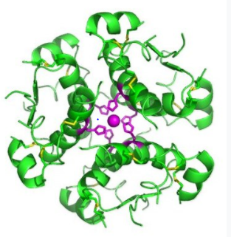
Insulin – production and effects
Peptide hormone type
Produced by beta cells of the pancreatic islets.
Release is stimulated by rising blood glucose levels.
Binds to receptors on tissue cells, allowing glucose to be absorbed from blood into cells – used for cellular respiration.
Stimulates conversion of glucose to glycogen in liver and muscle tissue
Learning Aim: Describe the production and effects of insulin.

Slide 5
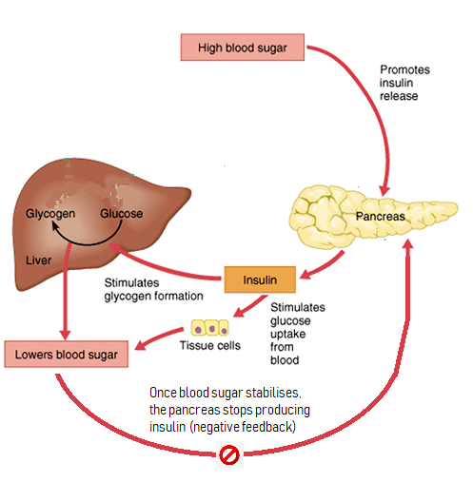
Insulin regulation
1: High blood sugar (eg because of food intake) is
detected by beta cells of pancreas.
2: The pancreas beta cells release insulin into the
bloodstream.
3: Insulin
stimulates body cells (esp muscle) to take up glucose from the blood.
Stimulates the liver to convert glucose to glycogen and store it.
4: As a result, blood sugar levels fall.
5: Once blood sugar stabilises the pancreas
detects this and stops producing insulin
(negative feedback).
https://youtu.be/OlHez8gwMgw
Learning Aim: Explain how blood sugar is regulated via insulin.

Slide 6
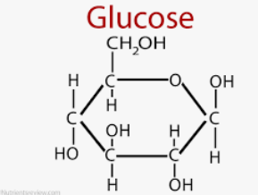
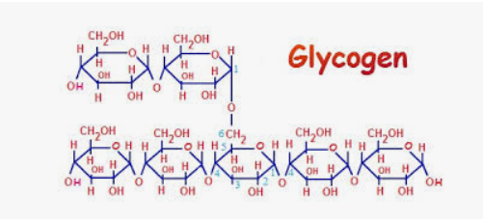
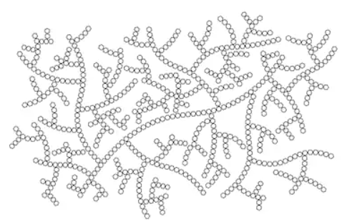
Wait, what the heck is glycogen???
Glucose is stored as glycogen in the liver in response to insulin.
Glucose is a simple sugar. Glycogen is a more complex sugar:
Glycogen is turned back into glucose when blood sugar is low.

Slide 7
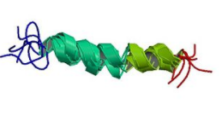
Glucagon – production and effects
Peptide hormone
Produced by alpha cells of the pancreatic islets
Release is stimulated by falling blood glucose levels
Stimulates liver to convert glycogen to glucose and release it into the blood
Note: Glucagon is a hormone. Glycogen is the complex sugar stored in the liver. Glucagon makes the liver break glycogen down into glucose. Don’t mix them up! Sorry – it’s confusing.
Learning Aim: Describe the production and effects of glucagon

Slide 8
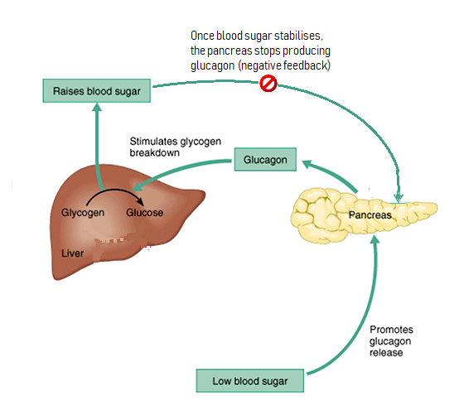
Glucagon regulation
Falling blood glucose is detected by alpha cells in the pancreas.
The pancreatic alpha cells release glucagon into the blood.
Glucagon stimulates the liver to converts glycogen to glucose.
Glucose is released into the bloodstream, and blood glucose levels rise
Once blood sugar stabilises, the pancreas stops producing glucagon (negative feedback).
Learning Aim: Describe how blood sugar is regulated via glucagon

Slide 9
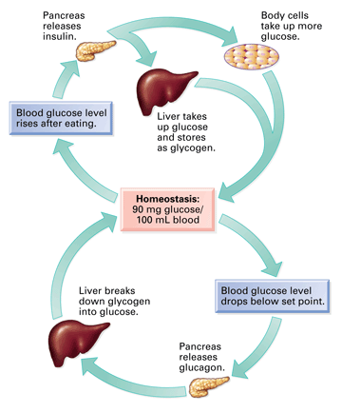
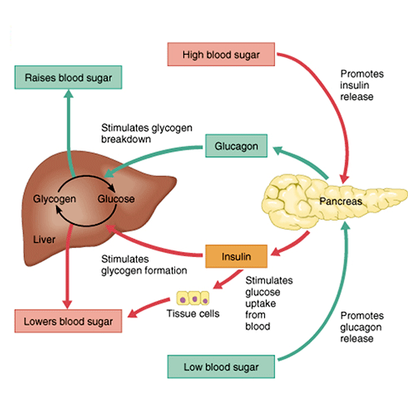

Slide 10
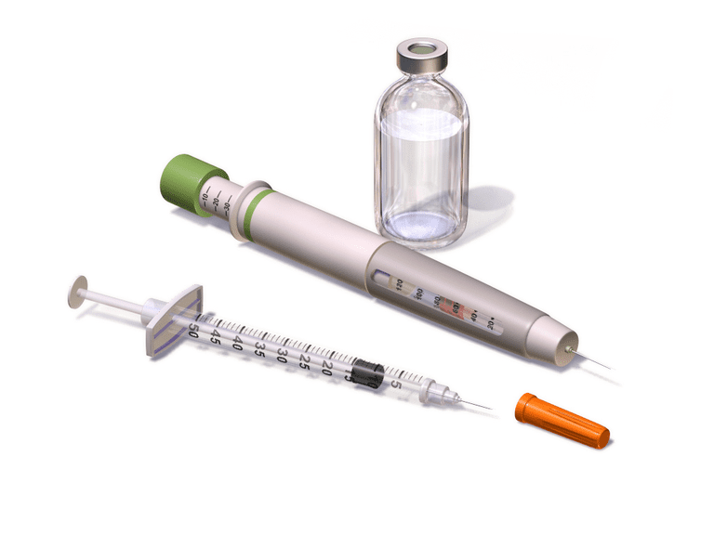
Diabetes mellitus: a disorder of glucose regulation
Common Cause(s) | Symptoms | Diagnosis | Treatment
Type 1 Diabetes: Autoimmune attack of pancreas destroys islet tissue. Little to no insulin produced so glucose cannot be absorbed by body cells. | Usually childhood onset Extreme thirst Excessive urination Weakness Fatigue Diabetic ketoacidosis – odd smelling breath due to ketones Death if untreated | Blood test to show high blood glucose levels. Presence of glucose in urine | Daily insulin injections, accompanied by careful diet and exercise regime.
Type 2 Diabetes: Lifestyle cause with some genetic components. Cells become resistant to insulin, so glucose cannot be absorbed | Adult onset (45+) Few symptoms at first As severity increases: Thirst Excessive urination Weakness Poor wound healing Headaches Dizziness |  | Lifestyle changes Weight loss Regular exercise Low sugar, good quality diet Medication to manage insulin resistance
Learning Aim: Describe Diabetes Mellitus Types 1 and 2 in detail

